Slide 1
Answer To Problem Task 3
Ethical Hacking internship
Submitted by: Kshitij Tiwari
/

Slide 2
REPORT
Title: Cross Site Scripting vulnerability
Domain name: http://vulnweb.com/
Subdomain name: http://testasp.vulnweb.com/
Summary: After thorough investigation, Vulnweb’s website https://testasp.vulnweb.com/ was found to be vulnerable to reflected injection of JavaScript, also called Reflected Cross Site Scripting (XSS). This happens due to one of the GET parameters "p" does not properly sanitizing user input, allowing an injection to occur.
Steps to Reproduce:
  Step 1: Prepare a Javascript payload. The code used here is: <script>alert(33)</script>
  Step 2: Visit the target website http://testasp.vulnweb.com/
/

Slide 3
REPORT
Step 3: Find the search option or any input field on the target website.
Step 4: Inject this JavaScript code properly into the vulnerable parameter, creating thus a crafted future GET request that will inject the payload.
GET / HTTP/1.1
Host: testasp.vulnweb.com
Upgrade-Insecure-Requests: 1
User-Agent: Mozilla/5.0 (Windows NT 10.0; Win64; x64) AppleWebKit/537.36 (KHTML, like Gecko) Chrome/88.0.4324.150 Safari/537.36
Accept: text/html,application/xhtml+xml,application/xml;q=0.9,image/avif,image/webp,image/apng,*/*;q=0.8,application/signed-exchange;v=b3;q=0.9
Accept-Encoding: gzip, deflate
Accept-Language: en-GB,en-US;q=0.9,en;q=0.8
Connection: close
Cookie: ASPSESSIONIDSSSCQCTQ=ENPMNEMDAGBNFIEFLCCOFMCD
Referer: http://www.testasp.vulnweb.com/Search.asp
/

Slide 4
Report
  Impact: With user interaction, an attacker could execute arbitrary JavaScript code in a victim's browser. This would allow an attacker to unwillingly make a victim:
    Perform any action in the identified endpoint
    View any information that the user is able to view
    Modify any information that the user is able to modify
  Mitigation: XSS attacks can be prevented by:
    Sanitizing and validating input fields.
    Installing Web Application Firewalls to filter bots and malicious activity.
    Keeping software updated.
  Proof of Concept screenshots and video is attached below:
  answer 3-1.png, answer 3-2.png, answer 3-3.png
  answer3.mkv
/

Slide 5
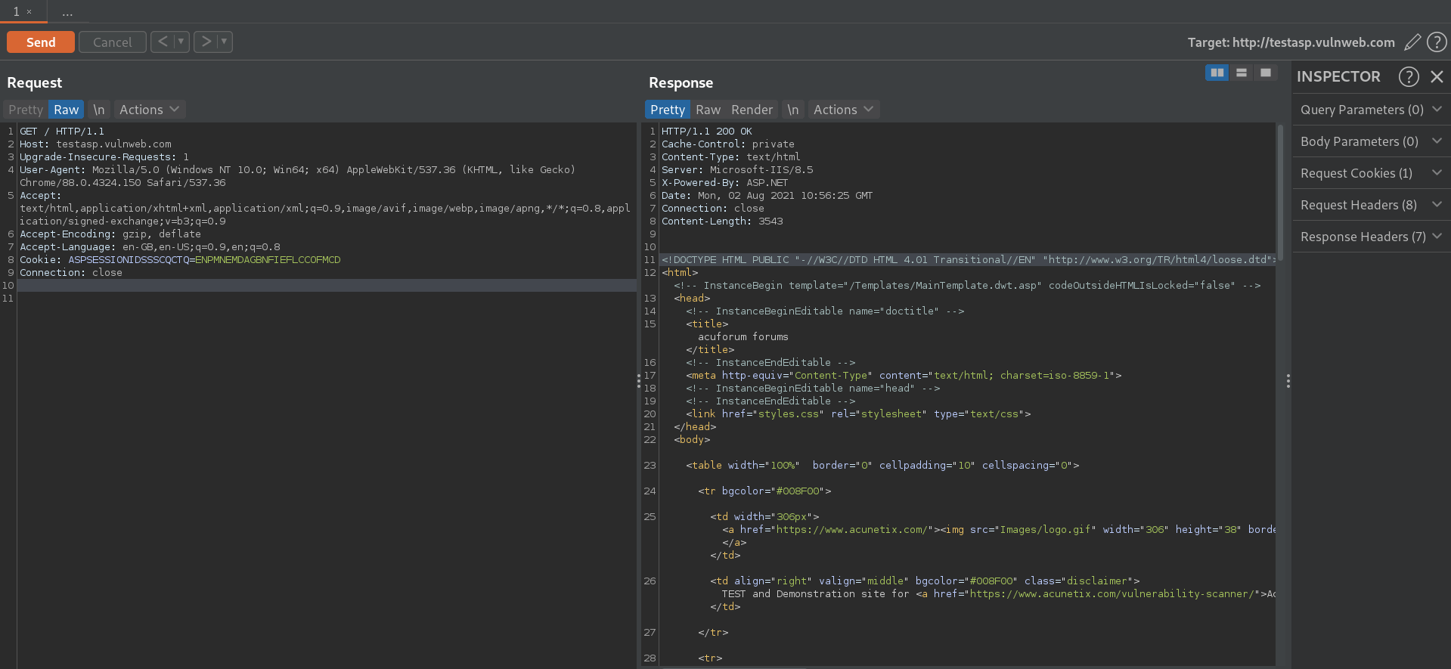
Screenshot
/

Slide 6
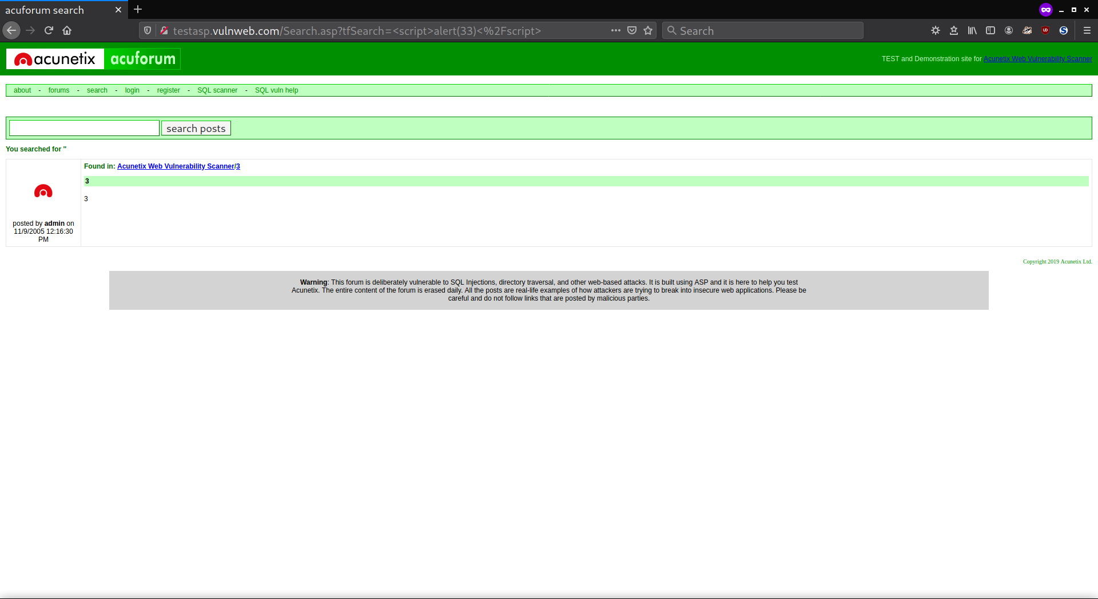
Screenshot
/

Slide 7
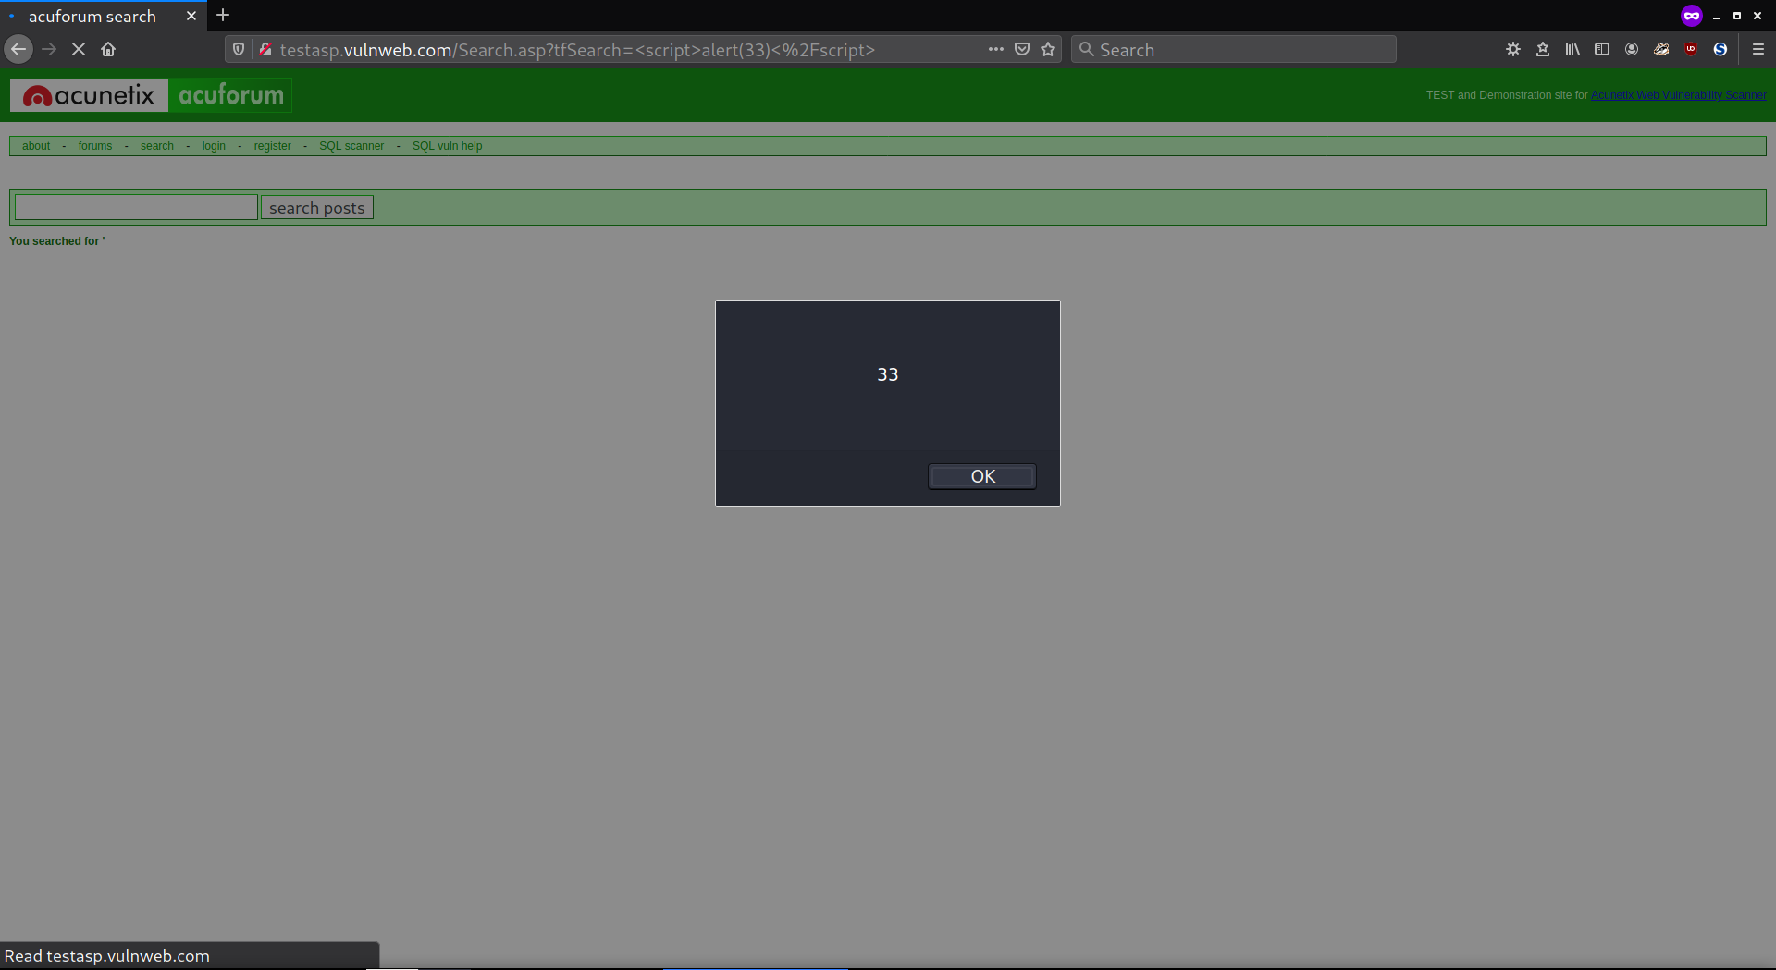
Screenshot
/

Slide 8
Proof Of Concept Video
/

